Slide 1
Collaborative OPen Omics (COPO) Project: Leveraging COPO to submit READ / Assembly / Sequencing Annotation data to ENA and get data published
DEBBY KU, PAPATHEODOROU GROUP
Research Software Developer
Notes:
Abstract: This seminar explores the evolution of the Collaborative OPen Omics (COPO) project as an open-source metadata broker in biodiversity research. With its capability to broker different data seamlessly, COPO has revolutionised the way by which researchers collaborate and share information. An integral part of COPO's development involves standardising as well as enriching metadata and enabling the integration of diverse datasets for publication to the European Nucleotide Archive (ENA) which facilitates public dissemination. Additionally, COPO's user-friendly API empowers users to query sample data efficiently, further enhancing accessibility and interoperability in biodiversity studies. Through its continuous evolution, COPO continues to drive innovation and collaboration in the field of bioscience research.

Slide 2
Overview
Data Broker
ENA READ / Sequencing Annotation / Assembly Submission
How COPO handles READ / Sequencing Annotation / Assembly Submission
Challenge & Future tasks
2

Slide 3
Data Broker
Metadata
The data to describe the sample
The data to describe the data file
Data File
Raw reads
Assembly
Sequencing Annotation

Slide 4
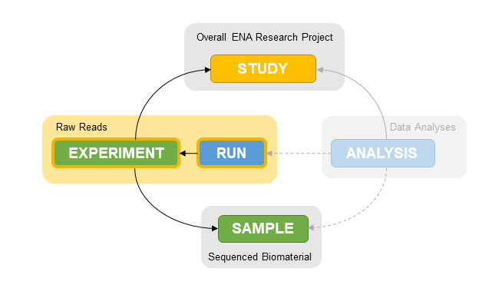
ENA READ Submission
RUN
RAW read files generated in a run of sequencing
Accession: ERRxxxxxx
Experiment
Metadata that describe the sample sequencing
Accession: ERXxxxxxx
File Format
.bam, readable with Samtools
PacBop Bam Files
.subreads.bam
.css.bam
.cram, readable with Samtools
multi fastq format, must be zip files
library layout
Single
Pair

Slide 5
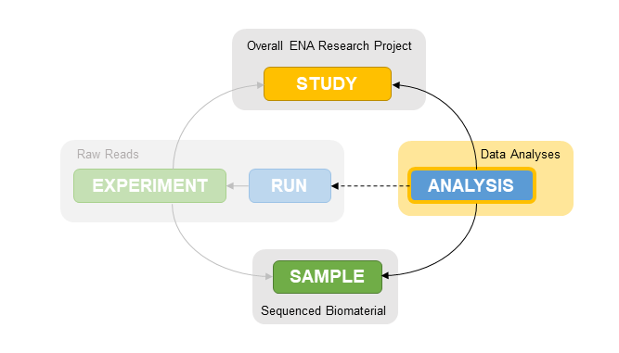
ENA Assembly Submission
Metadata
Data File
Contig
Scaffold
Chromosome
Accession
Internal use : ERZxxxxxx
External use after publish: GCA_xxxxxx

Slide 6
ENA Assembly Submission (cont.)
Assembly Level | File Requirements | Additional Information
Contig | 1 Manifest file | Defines essential metadata
 | 0-1 FASTA files | For unannotated assemblies
 | 0-1 EMBL flat files | For annotated assemblies
Scaffold | 1 Manifest file | Defines essential metadata
 | 0-1 FASTA files | For unannotated assemblies
 | 0-1 EMBL flat files | For annotated assemblies
 | 0-1 AGP file | For scaffold instructions from contigs
Chromosome | 1 Manifest file | Defines essential metadata
 | 0-1 FASTA files | For unannotated assemblies
 | 0-1 EMBL flat files | For annotated assemblies
 | 1 Chromosome list file | Indicate which sequences represent which ‘chromosomes’
 | 0-1 Unlocalised list files | For chromosomes containing unlocalised sequences
 | 0-1 AGP file | To submit unplaced contigs and indicate which scaffolds/contigs are assembled to form each chromosome

Slide 7
ENA Sequencing Annotation Submission
Accession
ERZxxxxxx
Metadata
Data Files

Slide 8
ENA Sequencing Annotation Submission (cont.)
Analysis Type | File Group Name | File Format | Allowed Quantity
Sequence Annotation | Sequence Methylation | TAB | 0-2
 | Single TAB | TAB | 1
 | Single FASTA | FASTA | 1
 | Single BED | BED | 1
 | Single GFF | GFF | 1

Slide 9
ENA Locus Tag Prefix
Register it at least 24 hours before submitting the annotated assembly
It is unique in ENA projects
Format:
Must begin with a letter
All letters must be upper case
Must from 3 to 12 characters in length
All characters must be alphanumeric with no diacritics and none such as -_*

Slide 10
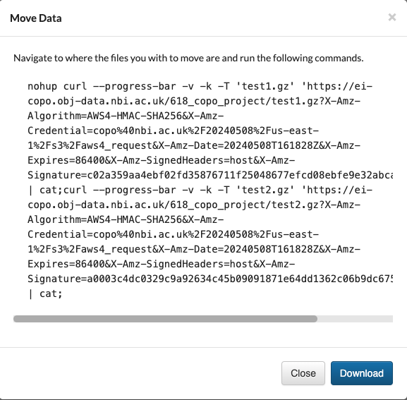
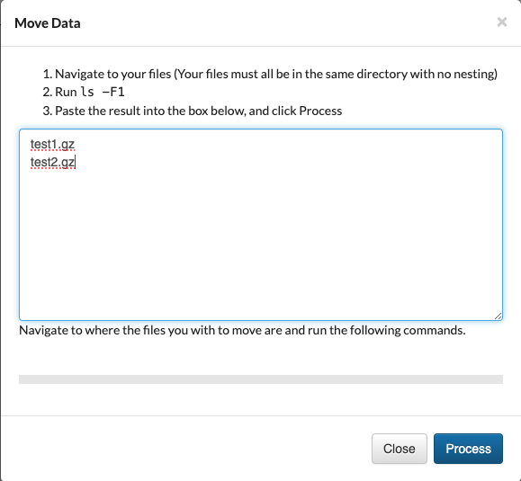
COPO Handles Data Files
Upload Data File to COPO
By browser
Slow, from COPO to ECS
Upload multiple files at one time
Max total file size : 2GB per upload
By terminal
Faster, directly to ECS
Generate commands for upload
valid for 24 hours only
Copy the commands or Download it as a file
Execute the commands on the terminal
For files in HPC, use scheduler

Slide 11
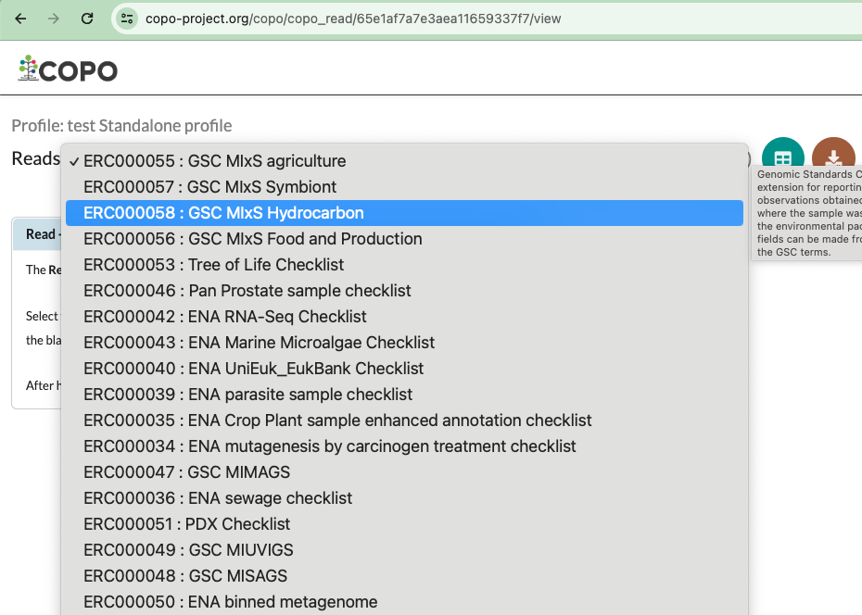

COPO Handles READ
Select a COPO profile
a standalone profile: for new sample
a shared profile: for existing COPO sample with biosample accession
Prepare a checklist
A Microsoft Excel worksheet for metadata
Update it daily from ENA
Download it from COPO
Fill in the worksheet
Upload Checklist to the profile
Wait for validation result
Make sure data file exists in ECS
Save the metadata to COPO
Submit

Slide 12
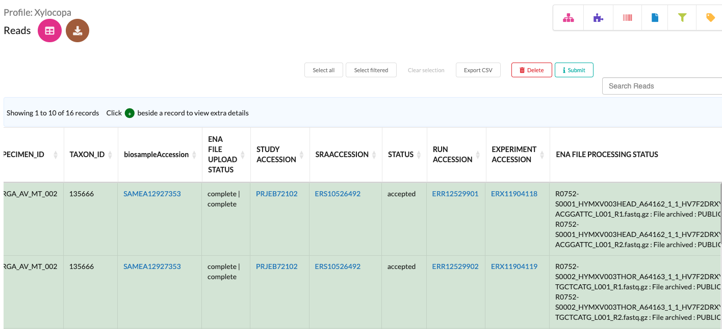
COPO Handles READ (cont.)
Monitor submission status
Accession returned from ENA almost immediately
It takes time for
Uploading data file to ENA
verifying the data file by ENA
Check ENA file upload status
Check ENA file processing status

Slide 13
COPO Handles READ (cont.)
Update READ by
Upload an updated data file to COPO
Upload an updated manifest to the same profile
Submit the READ again
Special Case:
A raw read file contains multiple samples
Create a virtual sample for the read file
Ask us to update the virtual sample in ENA
Add an attribute called : “sample composed of “
For biosample outside COPO
Use “standalone” profile and a “read” checklist

Slide 14
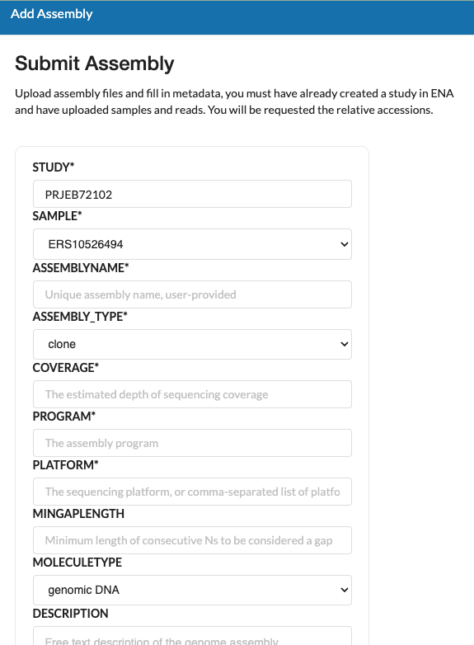
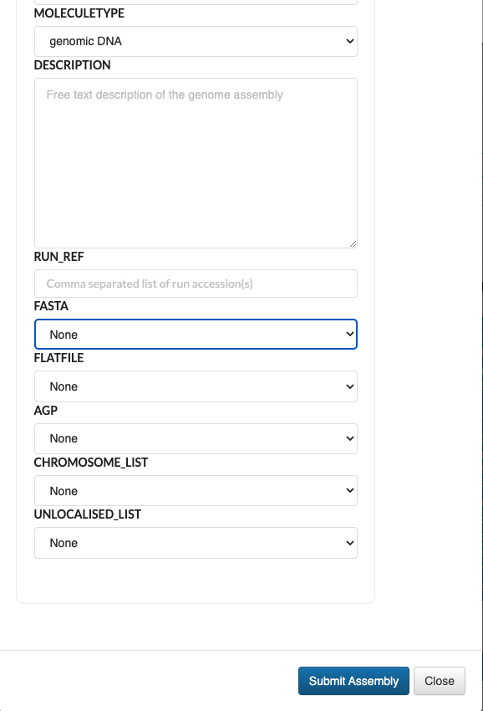
COPO Handles Assembly
Select a COPO profile
the profile with READ submission
Fill in the online form for
the metadata
the data file : must be in ECS already
Validate the data file locally with ENA tools and then submit ENA
No update after submission to ENA
Monitor ENA file processing status
Don’t store the GCA_xxxxxx accession

Slide 15
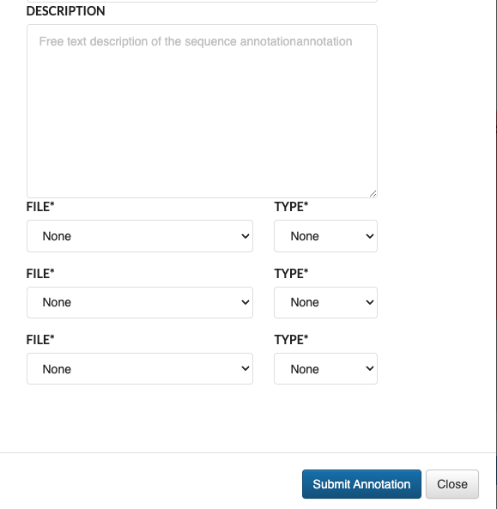
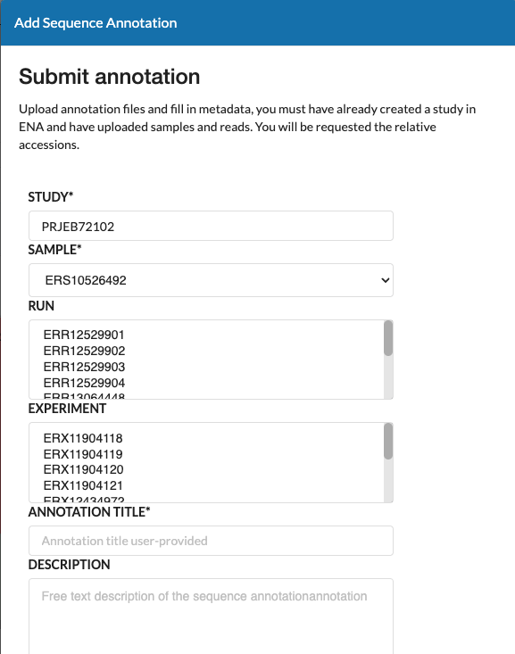
COPO Handles Sequencing Annotation
Select a COPO profile
the profile with READ submission
Fill in the online form for
the metadata
the data file : must be in ECS already
Validate data file locally by ENA tool and then submit ENA
Monitor ENA file processing status

Slide 16
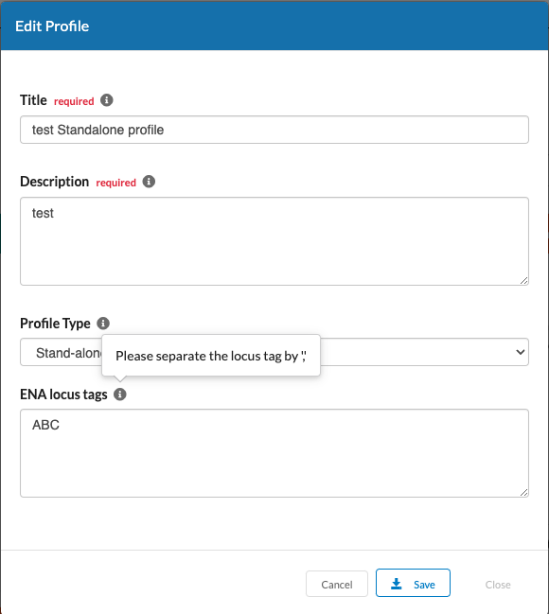
COPO Handles ENA Locus Tag Prefix
Input ”ENA Locus Tags” in the profile page
Submit to ENA
When a READ is submitted to ENA
When a profile is updated if the profile has been submitted to ENA before
Make sure it is in right format

Slide 17
COPO Handles ENA Project Publish
Submit ENA project
When READ is submitted
Status: private
Release date: 2 years later
Manually publish the ENA project
Select the profile in the “Work Profile” page
Click ”Publish”

Slide 18
Best Practices
Limit the number for READ into one profile
Performance issue

Slide 19
Challenge
Not a biology person
No actual data file for submission
Only test in ENA testing site
Limited support from ENA and NBI computing

Slide 20
Future tasks
When uploading files to ECS through browser, it is to COPO first, and then to ECS. Will try to upload to ECS directly
For assembly submission, we can’t select RUN accession but write it down manually. Will try to let user select the RUN from the same profile
Welcome any suggestions

Slide 21

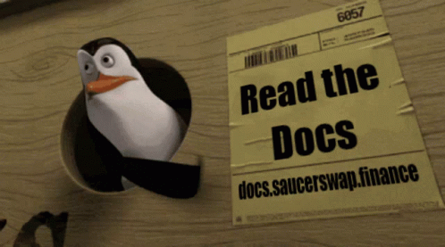
Need to submit data to ENA?
Submit your data to COPO by visiting: https://copo-project.org/copo
If you encounter any issues or have enquiries, contact the COPO team who would be happy to assist you.
ei.copo@earlham.ac.uk
http://copo-docs.readthedocs.io
22

Slide 22






Acknowledgements
BGE project
Papatheodorou Group
Rita Monteiro
Felix Shaw
Aaliyah Providence
ERGA project
Astrid Böhne
The Collaborative OPen Omics (COPO) project is supported by the Biotechnology and Biological Sciences Research Council (BBSRC), part of UK Research and Innovation, through the Cellular Genomics (CELLGEN) Grant BBS/E/ER/230001A, Data Infrastructure and Algorithms Group Grant EI-G-Data, Decoding Biodiversity (DECODE): Development of Novel Experimental and Bioinformatic Tools for Genomic Diversity and Analysis Grant BBS/E/ER/230002A and EI - Darwin Tree of Life Grant GP182.
Earlham Institute
Seanna McTaggart
David Wright
Krister Jazz Urog (Alumni)
Will Nash
Wilfried Haerty
Wellcome Sanger Institute
Radka Platte
Nancy Holroyd
Ian Still
Notes:
BBSRC - Biotechnology and Biological Sciences Research Council
CELLGEN - Cellular Genomics
DECODE - Decoding Biodiversity
____________________________
Seanna McTaggart - Programme Manager for the Darwin Tree of Life project

